Slide 1

Aditya Case Study Assessment :
Office Supplies Orders Case Study
Supported by Gaurav Singh Sir
Supported by Gaurav Singh sir
Satya Chandra Naga Sairam Gowthu
Krishna Teja Ryali
Guttula Somanadh Sai
Siva Venkata Rao Ijjapu
Vedurupaka Bhargava Venkata Satya Sai
Kurre Amruth
Maanasa Vayilada

Slide 2

Business Objective, Understanding and Approach
Business Objective
Understanding
The Company’s leadership team is mulling different strategies which will boost its future sales and in turn profit.​
They need assistance in performing some quantitative analysis and can use the generated insights as a guide in deciding on an appropriate strategy​.
An international furniture and supplies company wants to know its historical orders information and wants know how its business performed across various countries at their various markets.​
But the nature of the business is electronic commerce. It can supply their products to the customers of any type like corporate or home office. ​
Approach
The approach that solves the business problem with the data collection, Quality check followed by Visualization and EDD development.
The key steps are taken for the analysis of dataset that helps us to improve the sales and profits of the company.

Slide 3
Analysis/ Modeling Methodology
Data Preparation & EDA
Data Quality check
The dataset of “Office suppliers orders” consists of 23 variables
In that, 15 variables are object variables and 8 variables numerical variables.
There are no affected variables in the data set.
Postal Code is the only variable having missing values.
The percentage of missing value is 80.5%.
The variables in data doesn't require any cleaning
There are no duplicate records in the data.
Outliers
The data set has outliers for variables as sales ,Quantity ,Discount ,Profit , Shipping Cost.
The sales value crossing 5000 has not been noticed in the past dealings of company.
More than 50% discount is offered on less products.
According to the outliers, the companies proposes very less shipping cost on the delivered products.
According to data the loss percentage is more.

Slide 4
Extended Data Dictionary (EDD)
 | Variable Type | Min | Pc 1% | Pc 5% | Pc 25% | Pc 50% | Mean | Pc 75% | Pc 95% | Pc 99% | Max | % Missing values | % Unique values
Sales | Numeric | 0.4 | 3.69 | 8.8 | 30.7 | 85.05 | 246.4 | 251 | 1015 | 2301 | 2263 | 0% | 53.03%
Quantity | Numeric | 1.0 | 1.0 | 1.0 | 2.0 | 3.0 | 3.4 | 5.0 | 8.0 | 11.0 | 14.0 | 0% | 0.02%
Discount | Numeric | 0.0 | 0.0 | 0.0 | 0.0 | 0.0 | 0.1 | 0.2 | 0.6 | 0.7 | 0.8 | 0% | 0.05%
Profit | Numeric | -6599 | -351.5 | 83.9 | 0.0 | 9.2 | 28.6 | 36.8 | 211 | 587 | 8399 | 0% | 55.04%
Shipping Cost | Numeric | 1.0 | 1.1 | 1.32 | 2.61 | 7.7 | 26.4 | 24.4 | 111 | 286 | 933 | 0% | 32.66%
Findings from EDD :
Average Sales of the company is 246.490.
The mean value of the Quantity 3.476.
Average Percentage of the Discount is 2.76%
Average value of Profit is 28.61.
Average percentage of the Profit is 0.05%.

Slide 5
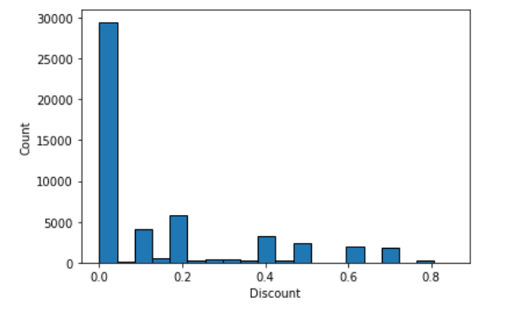
Analysis Results
Univariate Distributions on numerical variables
The discounts factor effects the profits of the company more when compared to the other factors
The distributions of variable is observed and analyzed for future recommendations.
Key Findings:
The company offers less discount and even 0% on most of the products which are not attracted by the customers.
More amount of discount is offered only on a single product which imposes a loss.
The profit of the company seems to be in negative values.

Slide 6
Analysis Results
Univariate Distributions on Categorical variables
Key Findings :
We did the analysis on market Vs Discount.
From that we are observing, The Europe market offers more discount than all other markets.
We did the analysis on Country Vs Profit.
United States has the highest profit.
We did the analysis on Quantity Vs Country.
The analysis states that the quantity of the product sold in a country.
We did the analysis on City Vs Shipping Cost.
By the analysis, we got to know that how much of shipping cost is required to deliver the product to the certain city.

Slide 7
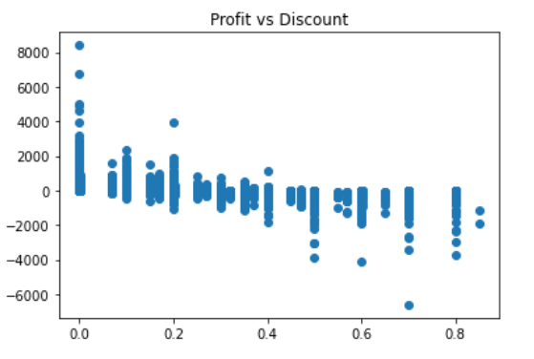
Bivariate Distributions
Key Insights:
The above plot shows the correlation between profit and discount
The X-axis represents the Discount.
The Y-axis represents the Profit.
If more discount is offered, then more loss is obtained.
From the above point, we can say that the discount is directly proportional to the loss.
So, we can conclude that the product should have limited discounts and offers.

Slide 8
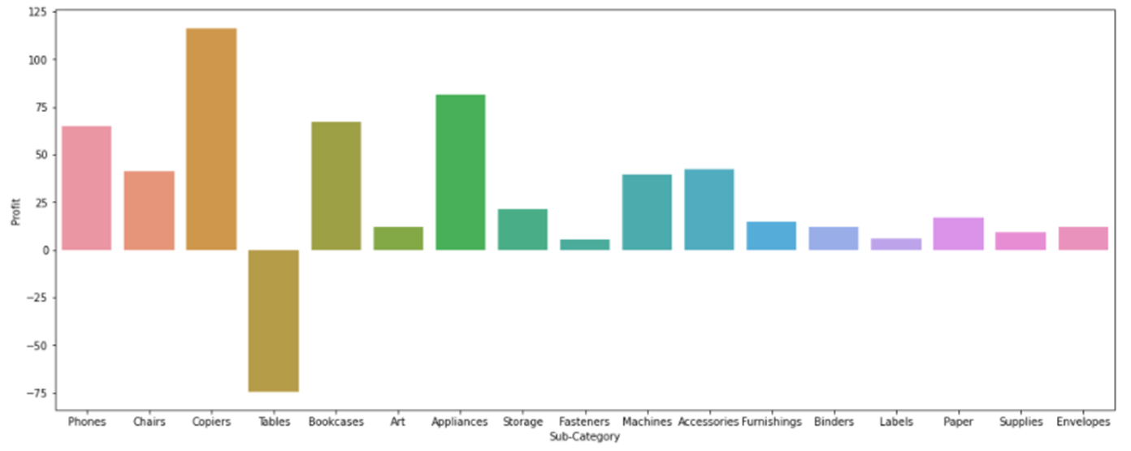
Key Insights:
The relevant insight is the sub-Category Vs Profit.
We noticed that the company had faced more loss due to more discounts offered on the product (Tables) but it is the most selling product when compared to the other products.
The product (Copiers) has the highest profit than other products in the above graph.
The product (Fasteners) has the least profit but it is not facing the losses.

Slide 9
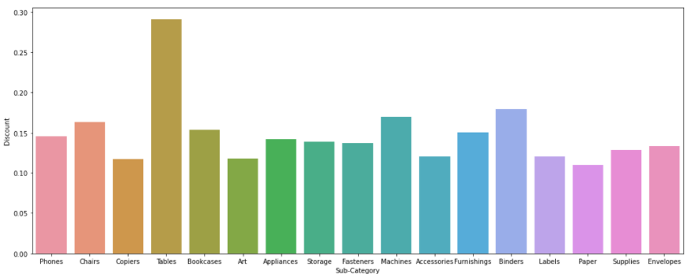
Key Insights:
The relevant insight is the sub-Category Vs Discount.
The company offers more discount on Product (Tables)
So, the offered discount leads in the increase the sales.
As the sales of the product is more but the company is facing loss due to the discount which is offered by the company on that product is more.

Slide 10
Analysis Outcomes and Recommendations
Analysis Outcomes :
33% of the customers gave the single orders
67% of the customers gave the repeated orders.
So, we should mainly focus on the 67% of repeated customers.
11% customers gave single orders i.e., 1 order.
Africa is the biggest market for the firm.
Mostly, It takes 4 days for delivering the order.
28% of the orders take 4 days long for delivering.
Recommendations :
The dataset provides the office supplies orders, sales, profit, discount etc.
It tells the historical order information of the company from past 4 years.
From over the past 4 years, the customers and the sales are also increased.
From the past 4 years, the product Tables offers the highest profits.
The company offers 0.8% discount on the product (Tables).
It increases the sales and customers.
But the company faces more loss for providing the discount on that particular product.

Slide 11

Final Recommendations
Reach Out to the Repeated Customers and offer them more benefits.
Use Brilliant Product Descriptions.
Use great product photos.
Set your eyes on your best product and focus on the high demanded products.
Use product reviews to your advantage and overcome the defects.
Manage shipping costs wisely and provide discounts as per the prices of individual products.
Optimize your site’s speed and make is user friendly and interactive.
Offer discounted bundles
Use video to increase sales and make the customers satisfied of their ord
Focus on security and offer trustable money back to the customer.

Slide 12
Summary
Approach & Solution
Insights/ Recommendations
The approach that solves the business problem with the data collection, Quality check followed by Visualization and EDD development.
The key steps are taken for the analysis of dataset that helps us to improve the sales and profits of the company.
We found the problems and came across with some solutions to improve the profits.
It tells the historical order information of the company over last 4 years
For increasing the customers concentrate on the people who buy office supplies regularly.
But give the discount accurately without loss effect for the company..
Mostly, It takes 4 days to deliver the product. So, try to deliver the product according to the customer need.

Slide 13


